Slide 1
ATYPICAL SQUAMOUS CELLS ASCUS AND ASC-H

Slide 2
THE 2001 BETHESDA SYSTEM
SPECIMEN TYPE –CP/TP
SPECIMEN ADEQUACY
Satisfactory (quality indicators)
Unsatisfactory (specify reason)
GENERAL CATEGORIZATION (OPTIONAL)
NILM
Epithelial cell abnormality
Other (endometrial cells above 40 yrs)

Slide 3
EPITHELIAL CELL ABNORMALITY SQUAMOUS
Atypical squamous cells
Of undetermined significance (ASC-US)
Cannot exclude HSIL (ASC-H)
Low grade squamous intraepithelial lesion (LSIL) Encompassing: HPV/mild dysplasia/CIN 1
High grade squamous intraepithelial lesion (HSIL) Encompassing: moderate and severe dysplasia, CIS; CIN 2 and CIN 3
With features suspicious for invasion (if invasion is suspected)
Squamous cell carcinoma

Slide 4
ASCUS- CRITERIA
The nuclei are two and a half to three times the area of the nucleus of a normal intermediate squamous cell.
Slightly raised n/c ratio
Minimal hyperchromasia, minimal irregularity in chromatin distribution and nuclear shape.
Nuclear abnormality associated with dense orangeophilic cytoplasm.

Slide 5
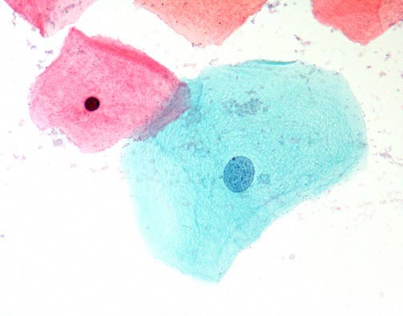
Superficial and Intermediate squamous cells

Slide 6
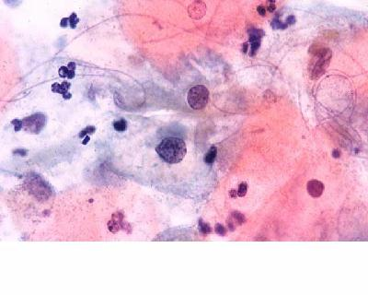
NILM-REACTIVE CHANGES

Slide 7
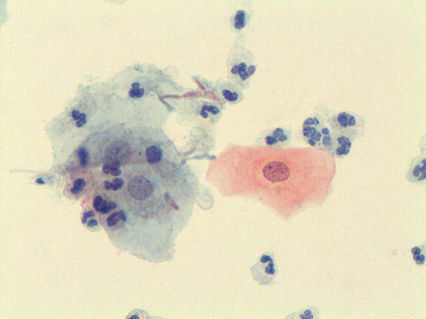
NILM-REACTIVE CHANGES

Slide 8
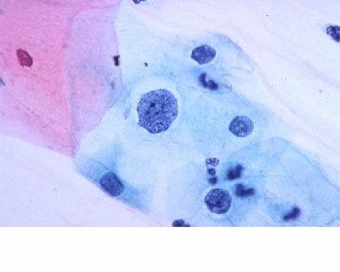
ASCUS

Slide 9
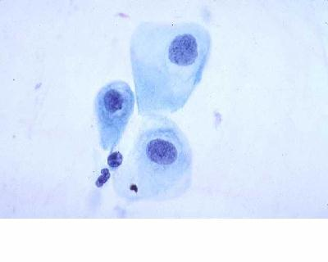
ASCUS

Slide 10
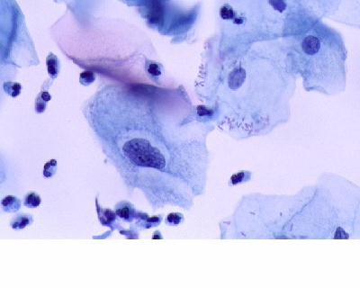
ASCUS

Slide 11
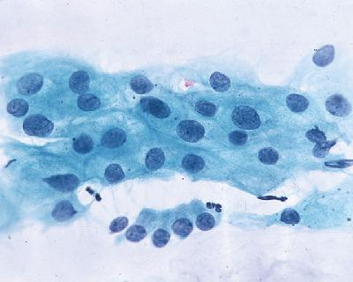
ASCUS

Slide 12
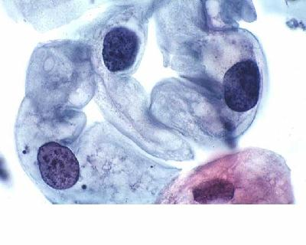
LSIL

Slide 13
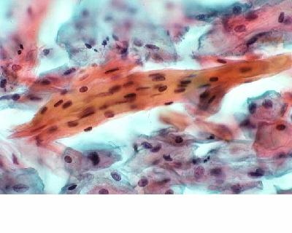
ASC-US PARAKERATOSIS

Slide 14
ASC-H CRITERIA
Cells occur singly or in small fragments of less than 10 cells.
Cells are size of metaplastic cells with nuclei about one and a half to two and a half times normal
N/c ratio is similar to HSIL
Asses degree of nuclear hyperchromasia, chromatin irregularity and abnormal nuclear shapes.

Slide 15
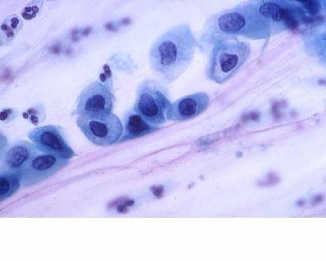
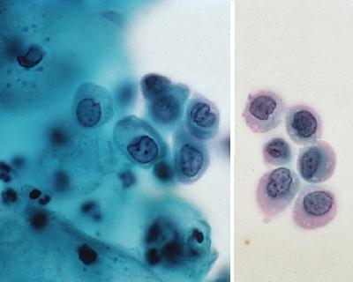
ASC-H AND HGSIL

Slide 16
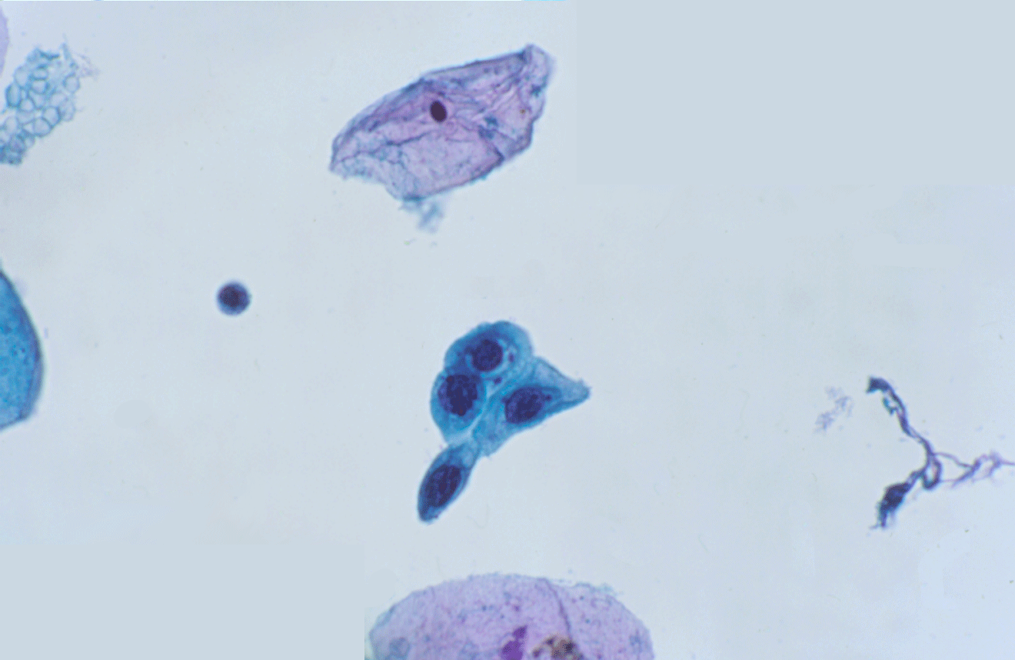

Slide 17
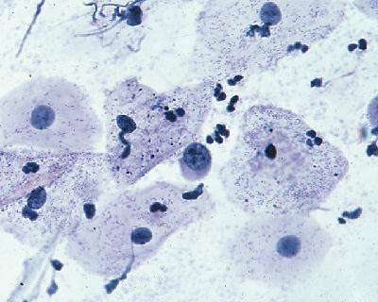

Slide 18


Slide 19
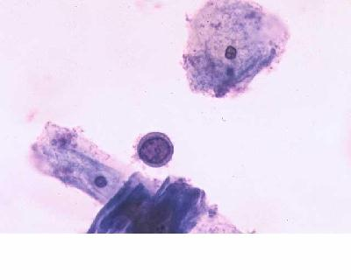

Slide 20
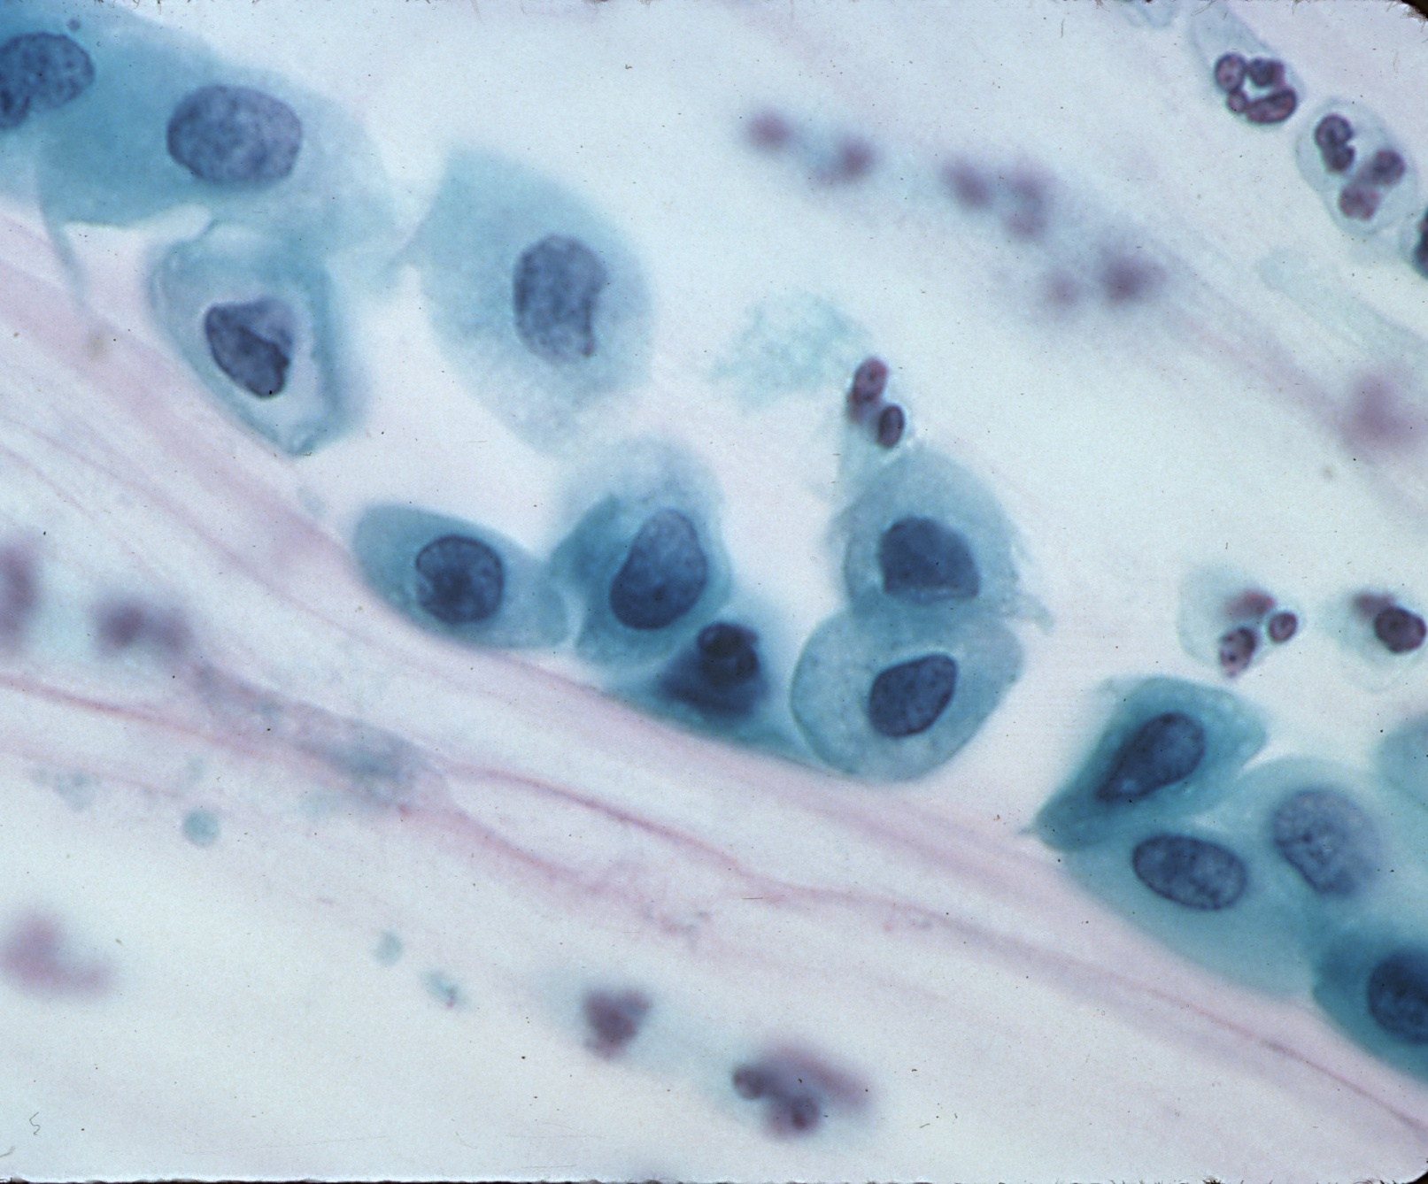

Slide 21
ASC-H CROWDED SHEET PATTERN
Crowded cluster of cells where there is loss of polarity and the cells are difficult to visualize.
Dense cytoplasm, polygonal cell shape, fragments with sharp nuclear edges favour glandular over squamous

Slide 22
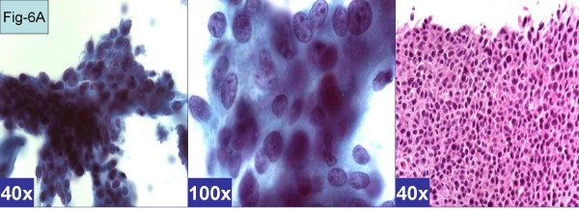
ASC-H CROWDED CELL PATTERN

